Slide 1

Box
Anna

Slide 2

Use Case UC-4: Logout
Related Requirements: REQ-4-user need to log out Initiating Actor: senders and receivers Actor’s goal: exit page of short time storage Participating Actors: data processor Preconditions: the system is working and the user completed the process of saving package in the cabinet Post conditions: none Flow of Events for Main Success Scenario: ----->a. User clicks the “MINE” button in the main interface. <-----b. System displays the personal center interface to the user. ----->c. User clicks the “log out” button. <-----d. System prompted the user to ensure to log out. ----->e. User clinks “Yes” to log out. <-----f. System stores the operate logs to database and shutdown.

Slide 3
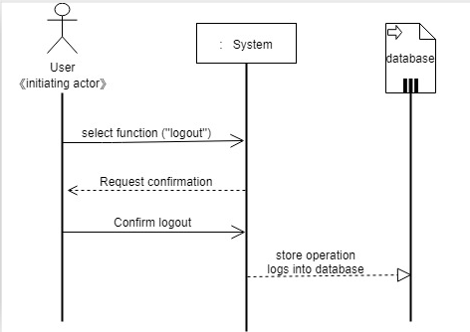
Sequence Diagram
UC-4: Logout

Slide 4
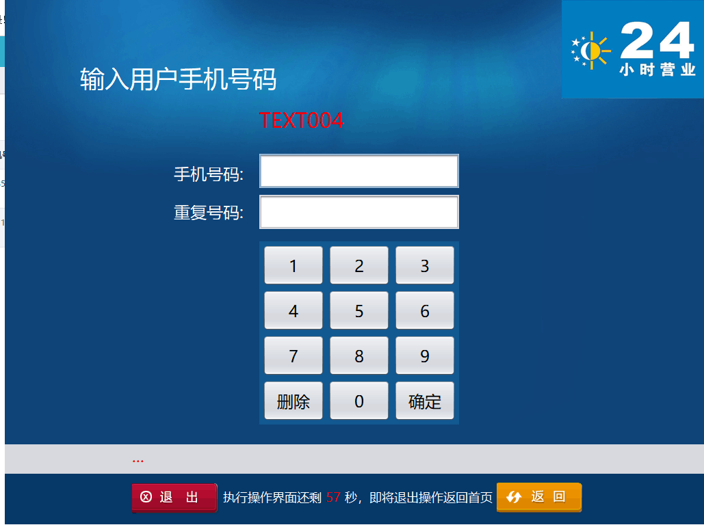

Slide 5
Use Case UC-（14） Cancel occupancy mark
Related Requirements: REQ-6, REQ-9,REQ-12 Initiating Actor: any of :User, Software, Actor’s Goal: restoration of cabinet usability Participating Actors: LockDevice, Timer, Memorizer, Preconditions: The LockDevice and code verification device of the cabinet are natural. User has been sent the pick-up code. Flow of Events for Main Success Scenario: include::Send pick-up code(UC-12), Scan pick-up code(UC-13), Cancel occupancy mark(UC-14) ----->a: User opens the application and selects the menu item”close the sale”. <-----b: system provide the pick-up code to user. c:the system access database to verify the account information-----> database <-----d: system cancel occupancy mark successful or not e:system store the operation logs to database-----> database

Slide 6
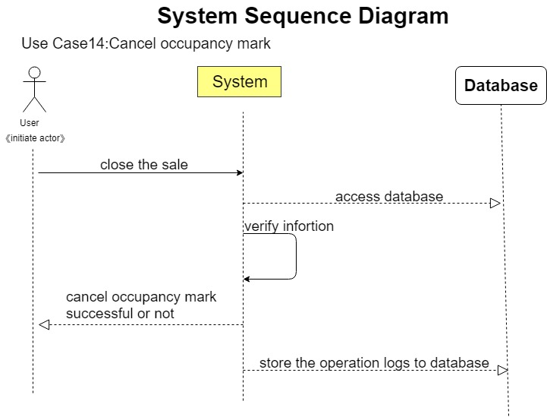

Slide 7
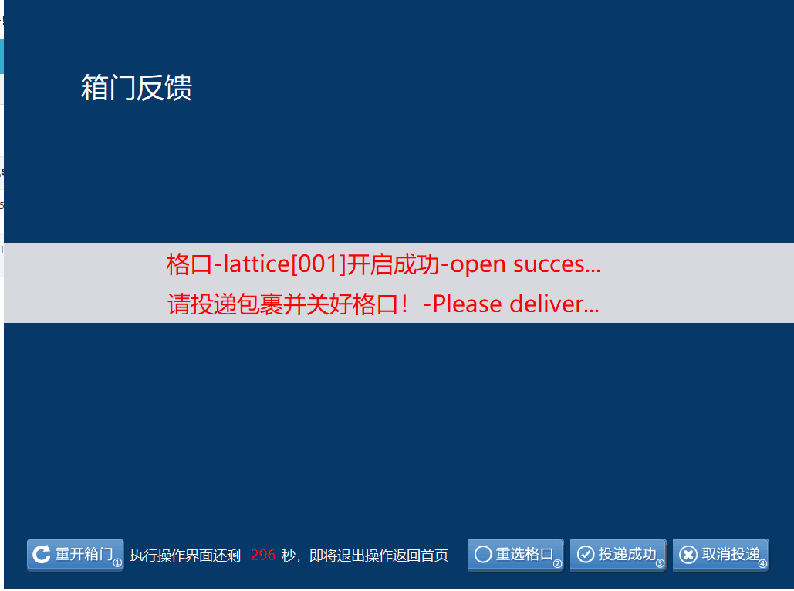

Slide 8
static class RunTimeThread implements Runnable {
@Override
public void run() {
while (true) {
try {
timetemp--;
if (timetemp > overTime){
lblSeconds.setText(CCommondFunc.lpad(timetemp, 2));
}
else if (timetemp == overTime){
CTxtHelp.AppendLog("[UI] 倒计时结束,操作超时-End of countdown, operation timeout");
CDataMgr.MainHandle.OnEventShowForm(oFormCase, CBaseEnum.RedirectType.Redirect_Null, param);
}
}
catch (Exception e) {
String err = "倒计时异常:-Countdown anomaly" + e.getMessage();
CTxtHelp.AppendLog("[Error] " + err);
UI.CSystemDAO.getInstance().AddWebLog(CBaseEnum.SystemLog_SoftException, err);
System.exit(0);
}
try { Thread.sleep(1000); } catch (InterruptedException e) {}
}
}
}
}

